Slide 1
MDS 6212: AQUMON Robo-Advisors
invest-it-and-forget-it investment journey
ID Name

Slide 2
Background
Background for aqumon

Slide 3
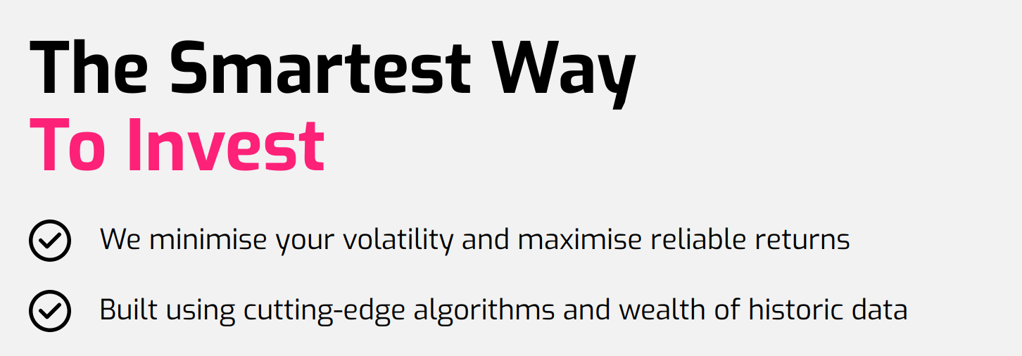
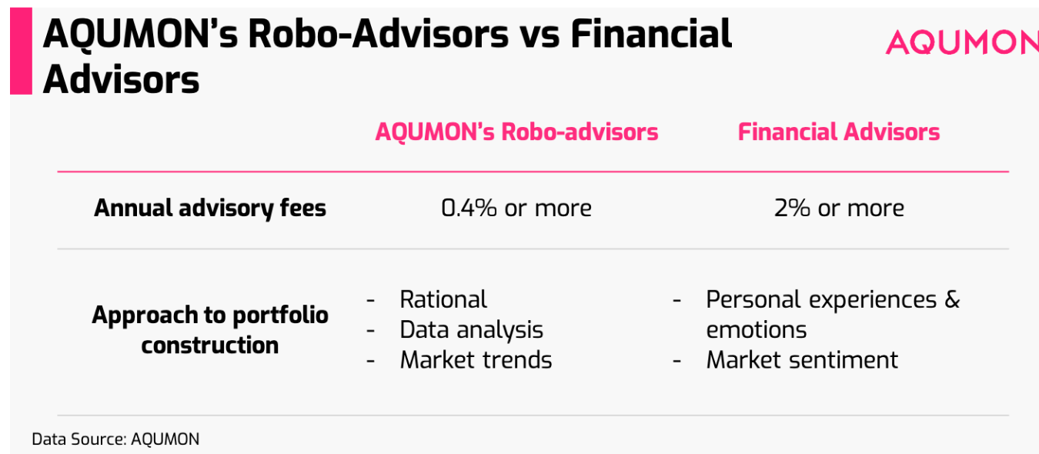
Background
Background for Business Oppotunity.

Slide 4

Business Model

Slide 5
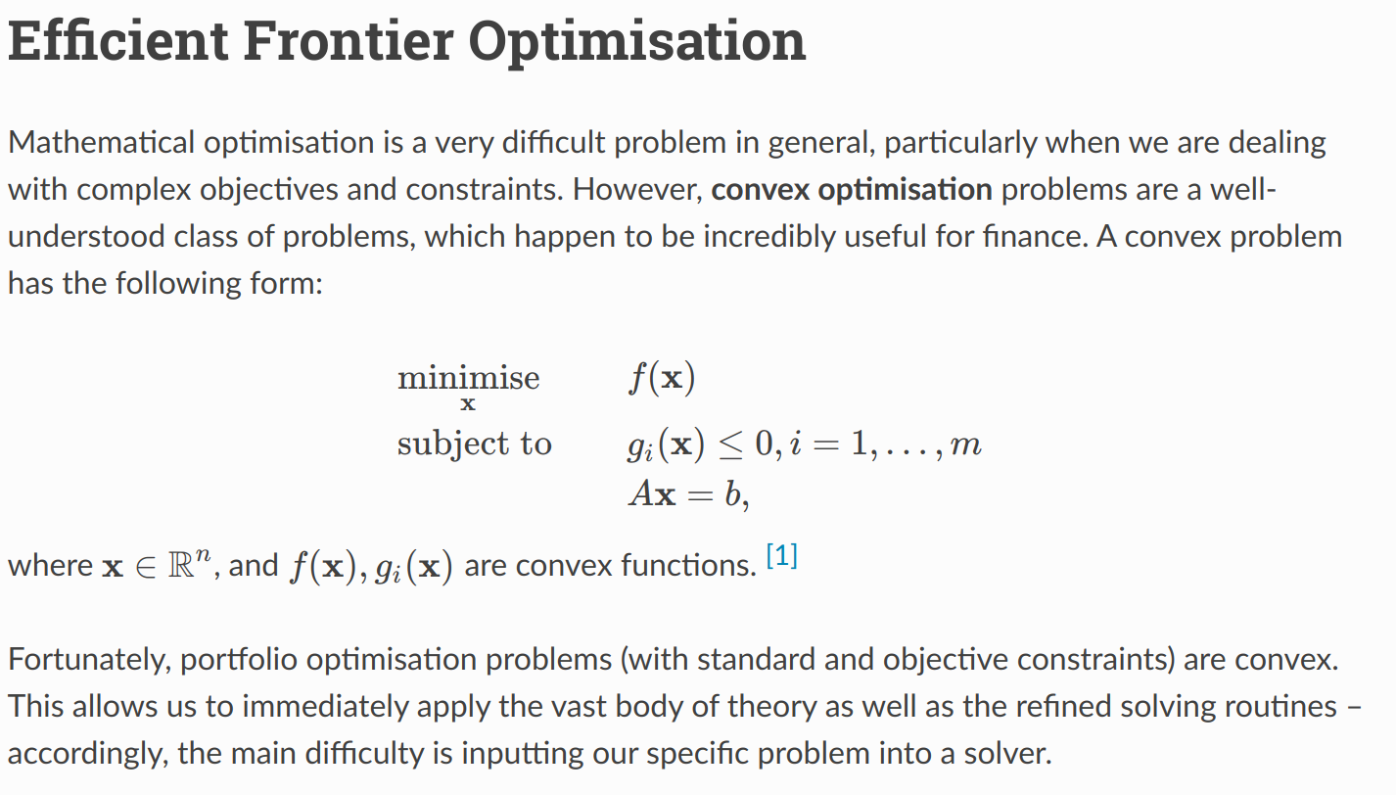
Markowitz Efficient Frontier (这页ppt介绍3种：max return, min risk, max sharpe)

Slide 6
Black Litterman why improve
Resulting portfolios of MVO tend to perform shockingly badly in practice, worse than if you were to just equally-weight the assets.
As it happens, the major cause of problems is the use of mean historical returns to estimate future returns.
The Black-Litterman model attempts to improve on this by using a clever Bayesian scheme to construct the expected returns vector.

Slide 7
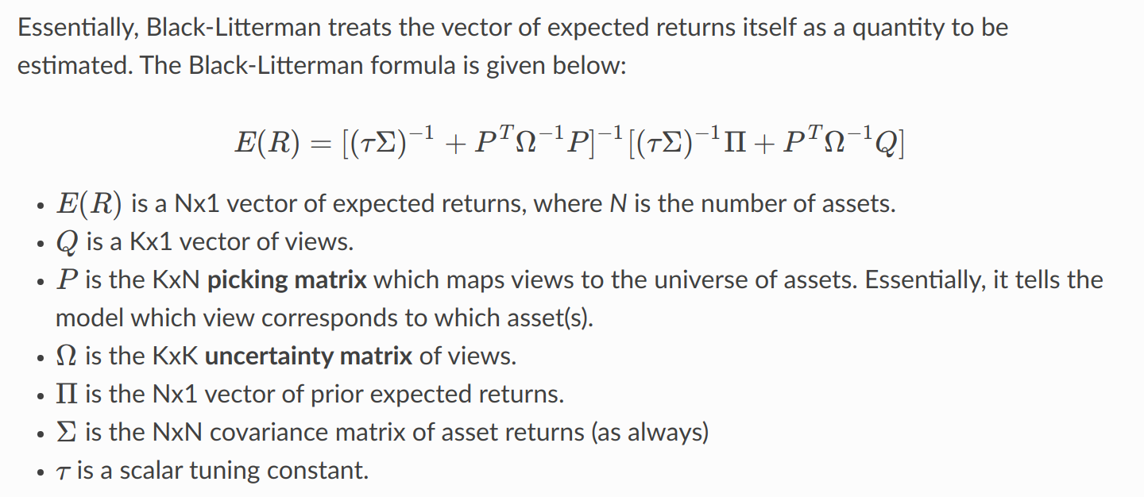
Black Litterman: Basic Idea

Slide 8
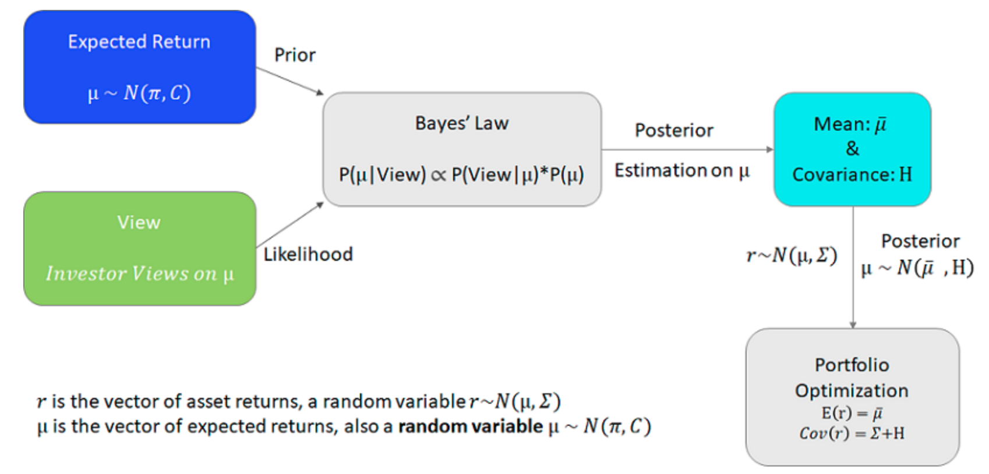
Black Litterman: Essentially ------ Beysian Method
Picture From : https://ww2.mathworks.cn/help/finance/black-litterman-portfolio-optimization.html;jsessionid=8c1c8e91322d90e4bcea951cf62e

Slide 9
Replicate key component Basic Assumptions: 这部分待考虑
1.
2.
3.

Slide 10
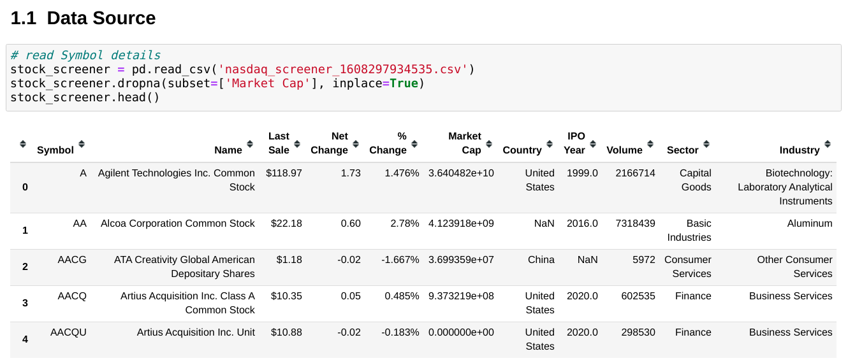
DATA INFO

Slide 11
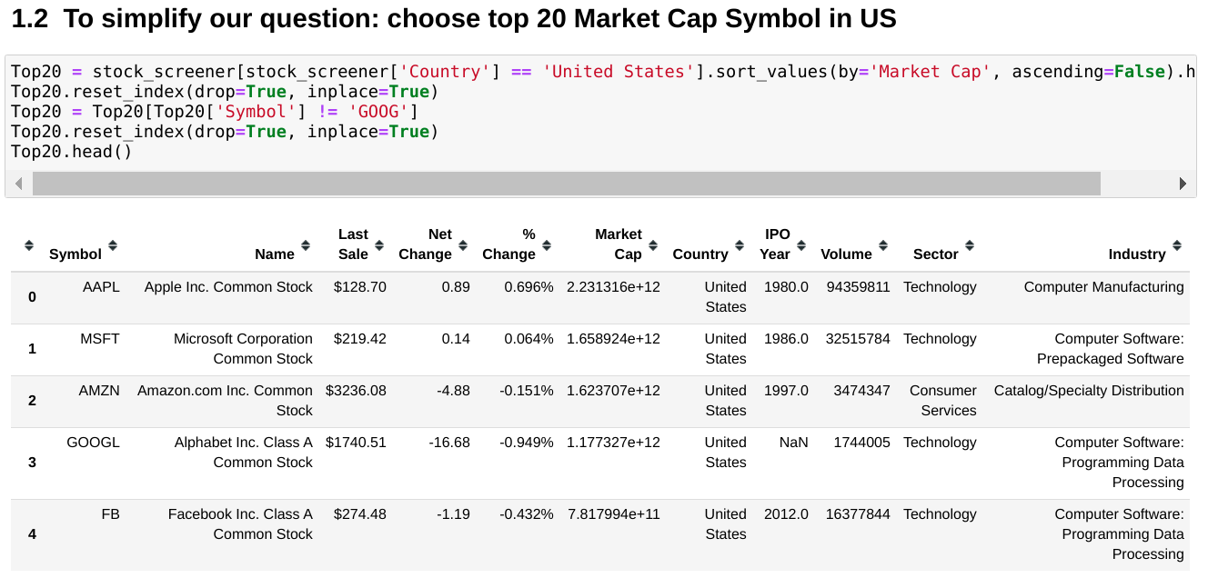
DATA INFO

Slide 12
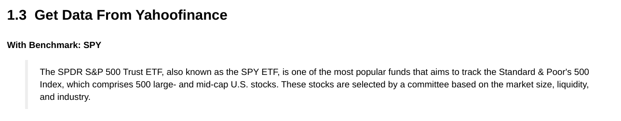
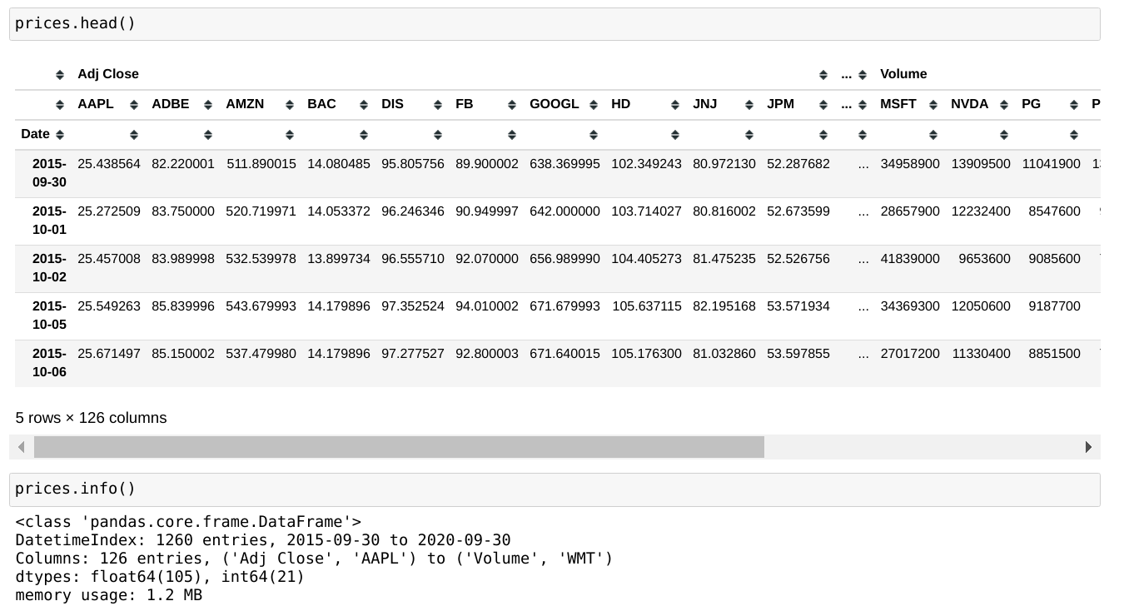
DATA INFO

Slide 13
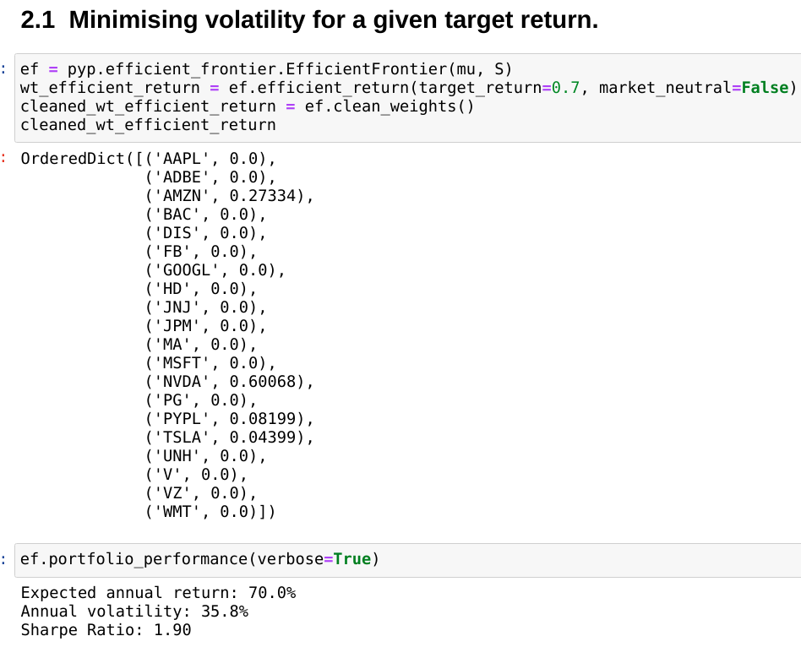
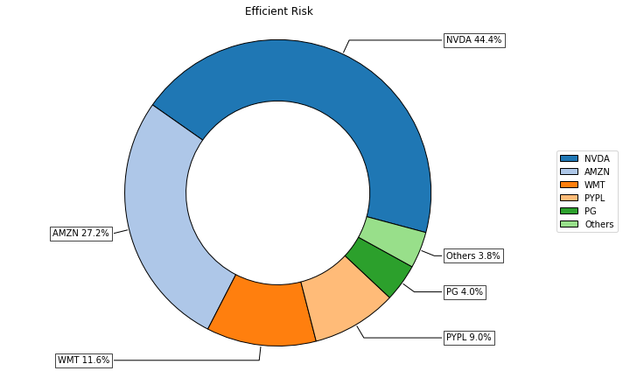
Efficient Frontier —— Minimize Risk

Slide 14
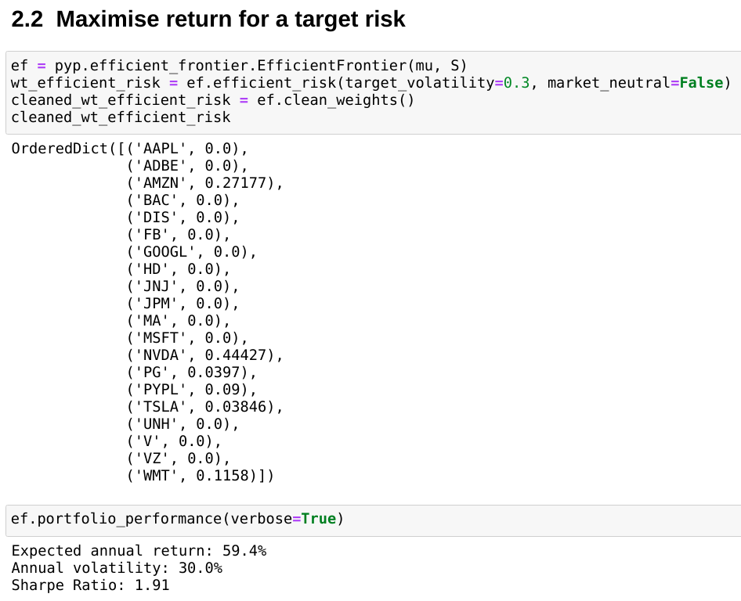
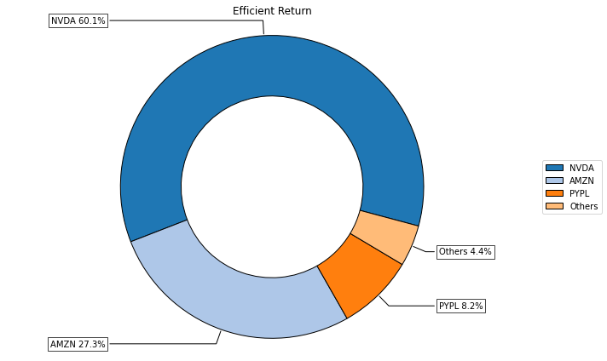
Efficient Frontier —— Maximize Return

Slide 15
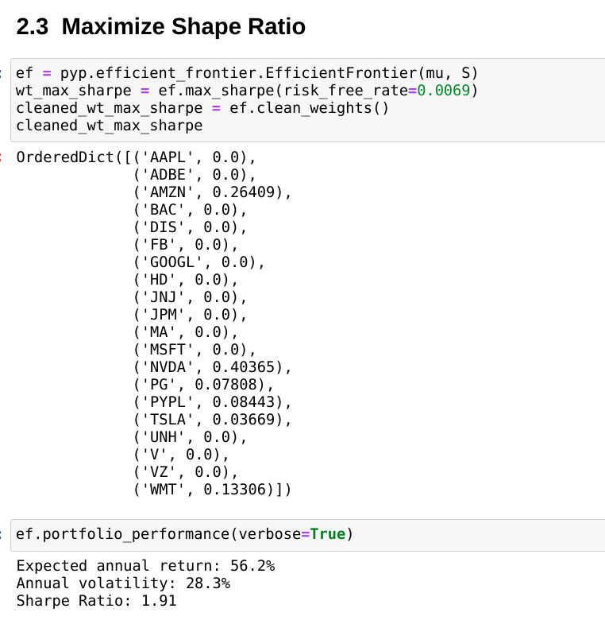
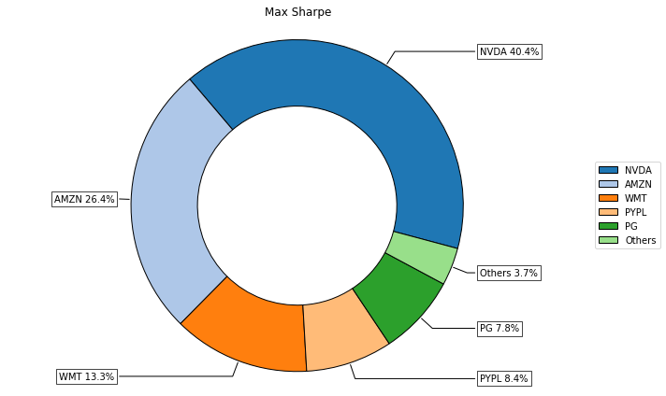
Efficient Frontier —— Maximize

Slide 16
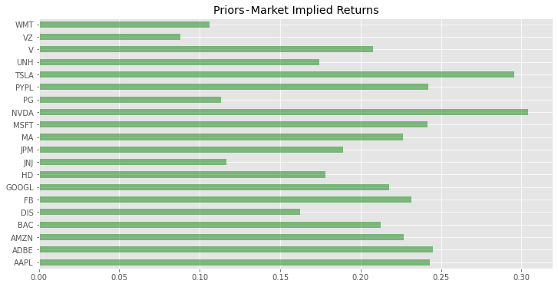
Black Litterman: Construct Prior
Part of the insight of Black and Litterman’s 1991 paper was that the current market-capitalisations of stocks can be used to construct a reasonable prior estimate of returns.

Slide 17
Black Litterman: Create Views
A view is just a forecast you have of the future returns of an asset. It is different to the expected returns vector required by Efficient frontier optimisation
Use the annualized mean return of next two month’s return as our views.
In real case, we can combine with some machine learning technichs such as LSTM or some Time Series Prediction methods to generate our views. (absolute views)
需要调整

Slide 18
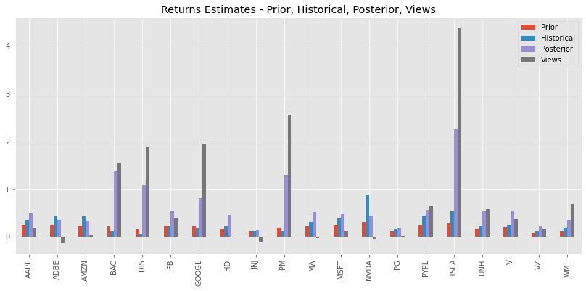
Black Litterman: Estimated Returns for Prior, Hist, Posterior, Views

Slide 19
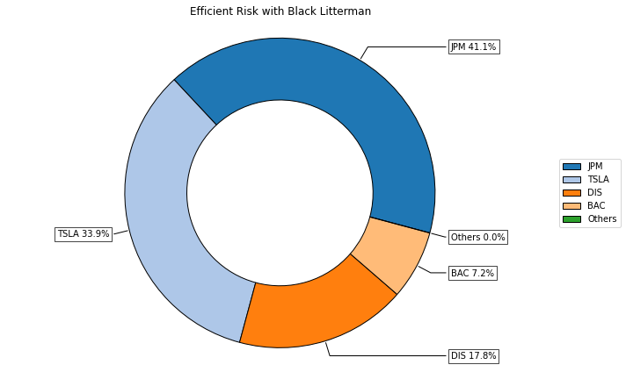
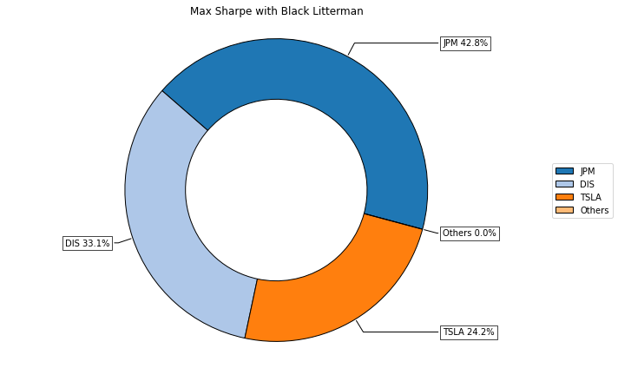
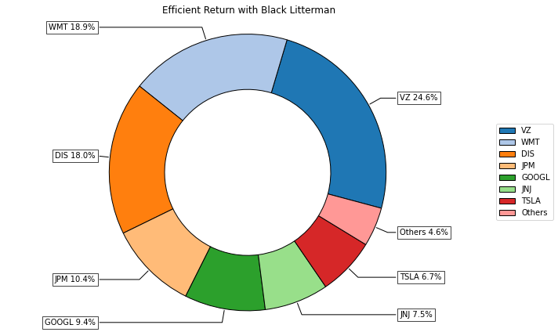
Black Litterman Results: combine with above 3
需添加对应的performance

Slide 20
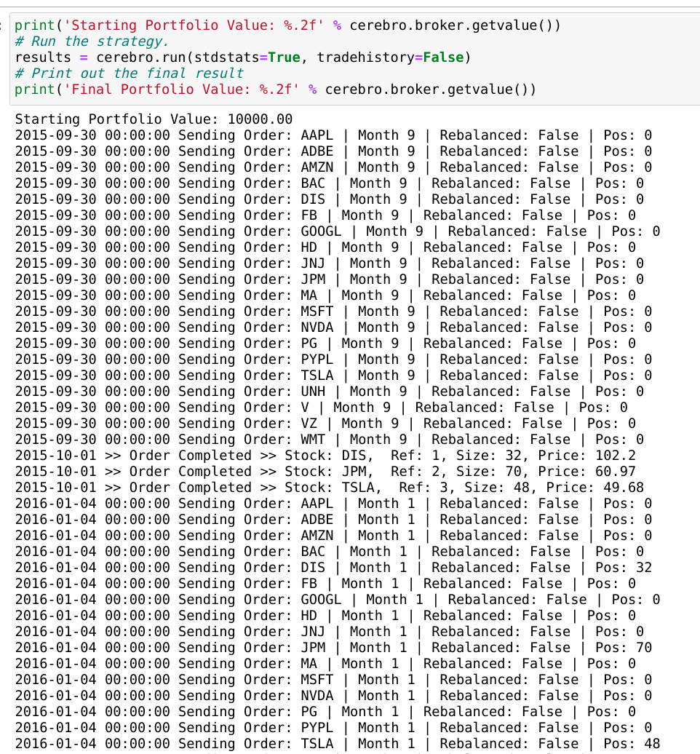
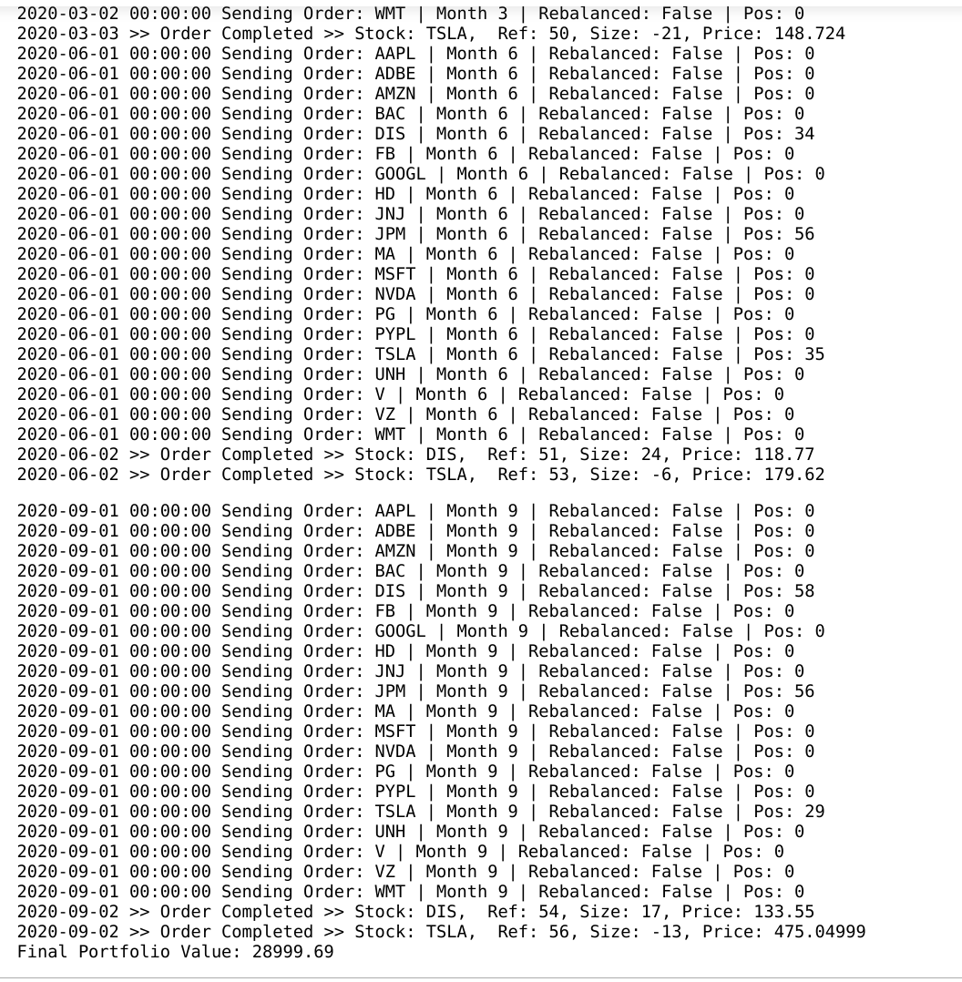
BackTesting —— Take BL+MaxSharpe for example
For Back Testing, We choose the month 1, 3, 6, 9 as our rebalance months. Set start cash as 10,000, and commission rate as 0.003

Slide 21
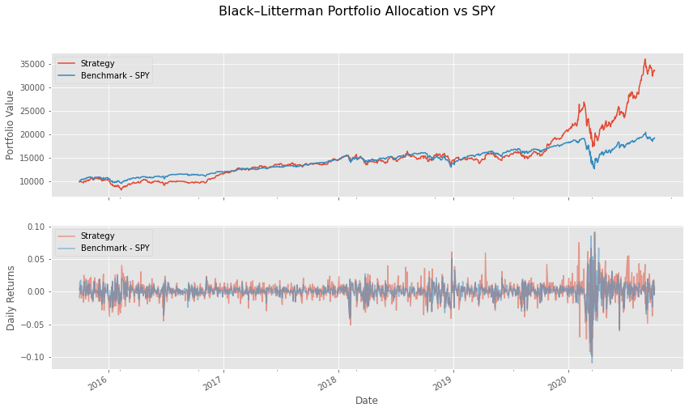
BackTesting —— Result

Slide 22
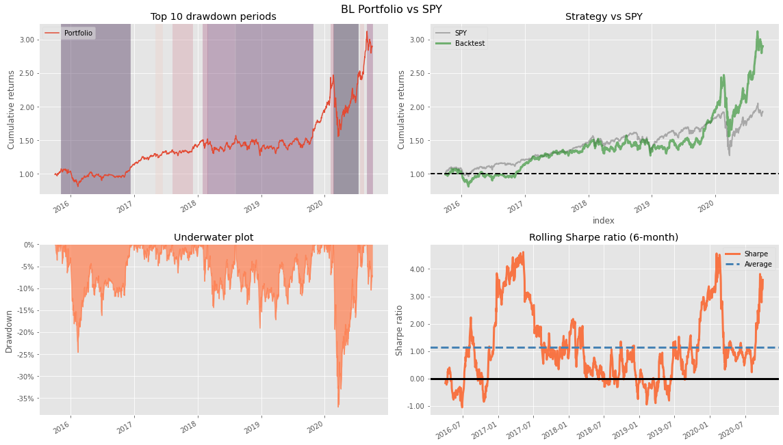
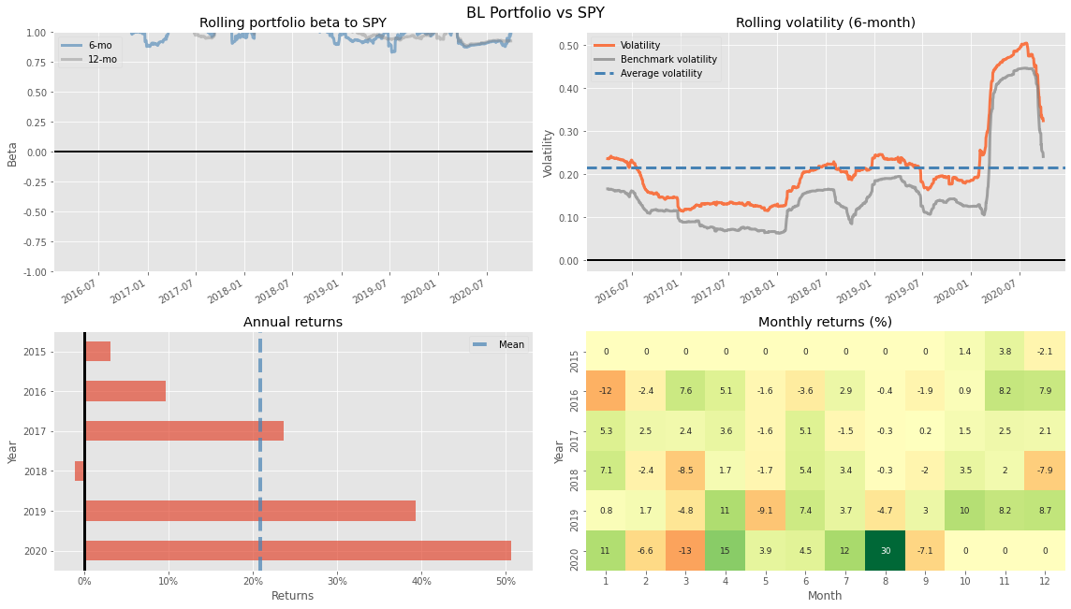
BackTesting —— Performance

Slide 23
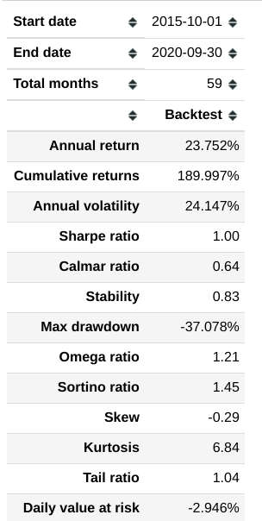
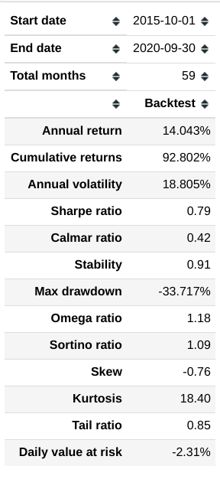
Performance 左BL， 右SPY

Slide 24
Future Work

Slide 25
Toy Demo

